Slide 1
Handling Exceptions in JSP

Slide 2
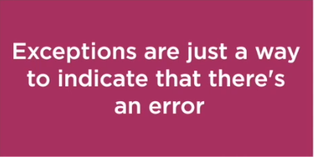
Handling Exceptions in JSP
Exception handling is an error handling mechanism

Slide 3
Handling Exceptions in JSP

Slide 4
Try-Catch Block
Exceptions Handling in JSP
isErrorPage and ErrorPage attribute
<error-page> tag

Slide 5
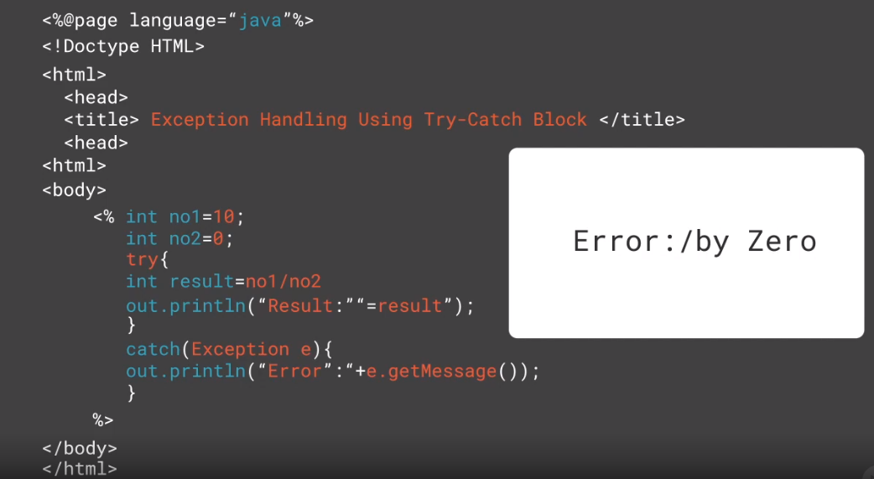

Slide 7
<error-page>
<exception-type>java.lang.Throwable</exception-type>
<location>/error.jsp</location>
</error-page>
Syntax
To Declare an Error Page for All Type of Exception

Slide 8
<error-page>
<exception-type>java.lang.ArithmeticException
</exception-type>
<location>/error.jsp</ location>
</error-page> </error-page>
Syntax
To Declare an Error Page for More Detailed Exception

Slide 9
<error-page>
<error-code>404</error-code>
<location>/error.jsp</location>
</error-page>
Syntax
To Declare an Error Page for Based on HTTP Error Status Codes

Slide 10

Assisted Practice
Exception Handling in JSP

Slide 11

Summary
Handling Exceptions in JSP

